Slide 1
COURSE CODE | COURSE TITLE | L T P J C
CSI3007 | Advanced Python Programming | 2 0 4 0 4
Dr. Sharmila Banu K Professor
Dept. of IoT
School of Computer Science and Engineering
08.07.2026

Slide 2
Module 1: Data Structures
Topics:
LIST, DICT, TUPLES and SET- Functions and Exceptions - Lamda Functions and Parallel processing - MAPS - Filtering - Itertools – Generators
At the end of Module 1, The students will be able to:
Understand the various data structures supported by Python language and apply the same in real time applications.

Slide 3
Session Topics
LIST, DICT, TUPLES and SET
Session outcome: The students will be able to Understand the data structures LIST, DICT, TUPLES and SET and use the same in real time applications.

Slide 4
Lists
Ordered collection of data
Data can be of different types
Lists are mutable (changeable )
Issues with shared references and mutability (with mutable objects, it does pass by reference)
Same subset operations as Strings
>>> x = [1,'hello', (3 + 2j)]
>>> x
[1, 'hello', (3+2j)]
>>> x[2]
(3+2j)
>>> x[0:2]
[1, 'hello']
With immutable objects, python follows pass-by-value.
Which data structure is immutable?
Tuples

Slide 5
Lists: Modifying Content
>>> x = [1,2,3]
>>> y = x
>>> x[1] = 15
>>> x [1, 15, 3]
>>> y [1, 15, 3]
>>> x.append(12)
>>> y
[1, 15, 3, 12]
x[i] = a reassigns the ith element to the value a
Since x and y point to the same list object, both are changed
The method append also modifies the list
What are the common list methods?
Insert(), extend(), remove(), pop(), clear(), index(),

Slide 6


Lists: Modifying Contents
>>>
>>> y = x
>>> z = x.append(12)
>>> z == None
True
>>> y
[1, 2, 3, 12]
>>> x = x + [9,10]
>>> x
[1, 2, 3, 12, 9, 10]
>>> y
[1, 2, 3, 12]
>>>
The method append modifies the list and returns None
List addition (+) returns a new list
What are the other methods that return None? Extend(), insert(), sort(), reverse()

Slide 7
More on List
append() extend()
clear() insert()
copy()
sort()
pop() remove()

Slide 8
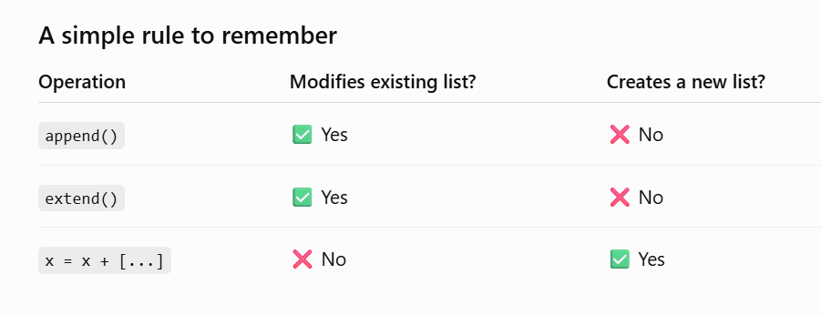
List Methods - Quiz

Slide 9
Stack using List
Stack = []
Size = 5
def Display():
if len(Stack)==0:
print ("Stack is empty") print ("Stack content is:") for i in Stack:
print (i)
def Push(element):
if len(Stack)<Size: Stack.append(element)
else:
print ("Stack is full")
def Pop():
if len(Stack)>0:
data = Stack.pop()
print ("Element removed from stack is", data)
else:
print ("Stack is empty")

Slide 10
Tuples
Tuples are immutable versions of lists
>>> x = (1,2,3)
>>> x[1:]
(2, 3)
>>> y = (2,)
>>> y (2,)
>>>
One strange point is the format to make a tuple with one element:
‘,’ is needed to differentiate from the mathematical expression (2)

Slide 11
Tuples
>>> x=(1,2,3)
>>> x
(1, 2, 3)
>>> x(1)=100
SyntaxError: can't assign to function call
>>> x[1]=100
TypeError: 'tuple' object does not support item assignment
>>> x.append(100)
AttributeError: 'tuple' object has no attribute 'append'
>>> x=(1,2,3)
>>> x (1, 2, 3)
>>> y=x
>>> y (1, 2, 3)
>>> x=(1,2,3,4)
>>> y (1, 2, 3)
>>> x
(1, 2, 3, 4)

Slide 12
Dictionaries
A set of key-value pairs – Duplicate keys - No, values - Yes( What about Duplicate keys - accepted, but not stored)
Dictionaries are mutable
>>> d = {1 : 'hello', 'two' : 42, 'blah' : [1,2,3]}
>>> d
{1: 'hello', 'two': 42, 'blah': [1, 2, 3]}
>>> d['blah']
[1, 2, 3]
>>> d={1:'one', 2:'two', 2:'three'}
>>> d
{1: 'one', 2: 'three'}

Slide 13
Dictionaries: Add/Modify
Entries can be changed by assigning to that entry
>>> d
{1: 'hello', 'two': 42, 'blah': [1, 2, 3]}
>>> d['two'] = 99
>>> d
{1: 'hello', 'two': 99, 'blah': [1, 2, 3]}
Assigning to a key that does not exist adds an entry
>>> d[7] = 'new entry'
>>> d
{1: 'hello', 7: 'new entry', 'two': 99, 'blah': [1, 2, 3]}

Slide 14
Dictionaries: Deleting Elements
The del method deletes an element from a dictionary
>>> d
{1: 'hello', 2: 'there', 10: 'world'}
>>> del(d[2])
>>> d
{1: 'hello', 10: 'world'}

Slide 15
Copying Dictionaries and Lists
The built-in list function will copy a list
The dictionary has a method called copy
>>> l1 = [1]
>>> l2 = list(l1)
>>> l1[0] = 22
>>> l1 [22]
>>> l2 [1]
>>> d = {1 : 10}
>>> d2 = d.copy()
>>> d[1] = 22
>>> d
{1: 22}
>>> d2
{1: 10}

Slide 16
Sets
A Set is an unordered collection data type that is iterable, mutable, and has no duplicate elements normal_set = set(["a", "b", "c"]) Adding an element to normal set: normal_set.add("d")
set(['a', 'c', 'b', 'd']) | >>> k=[1,2,3,3,4,4] >>> k [1, 2, 3, 3, 4, 4]
 | >>> l=set(k) >>> l set([1, 2, 3, 4])

Slide 17

Frozen Set
Immutable set cities = frozenset(["Frankfurt", "Basel", "Freiburg"]) cities.add("Strasbourg") Traceback (most recent call last): File "<stdin>", line 1, in <module> AttributeError: 'frozenset' object has no attribute 'add'
 | >>> grade frozenset(['A', 'A+', 'B', 'C'])
>>> grade=frozenset(['A', 'A+', 'B', 'C'])

Slide 18
Data Type Summary
Integers: 2323, 3234L
Floating Point: 32.3, 3.1E2
Complex: 3 + 2j, 1j
Lists: l = [1,2,3]
Tuples: t = (1,2,3)
Dictionaries: d = {‘hello’ : ‘there’, 2 : 15}
set = set(["a", "b", "c"])

Slide 19
Immutable Vs Mutable
Immutable objects cannot have their state changed and include:
  Numbers
  Strings
  Tuples
Mutable objects can have their state changed and include:
  Dictionaries
  Lists

Slide 20

Immutable Vs Mutable
Immutable >>> a=(1,2,3) >>> a (1, 2, 3) >>> b=a >>> b (1, 2, 3) >>> b+=(4,5) >>> b (1, 2, 3, 4, 5) >>> a >>>(1,2,3) >>>id(a) 34068080 >>> id(b) 32551392 | Mutable >>> c=[1,2,3] >>> c [1, 2, 3] >>> d=c >>> d [1, 2, 3] >>> d+=[4,5] >>> d [1, 2, 3, 4, 5] >>> c [1, 2, 3, 4, 5] >>> id(c) 34071736 >>> id(d) 34071736
Operation | Creates New List? | Changes Original List?
append() | ❌ No | ✅ Yes
extend() | ❌ No | ✅ Yes
+= | ❌ No (for lists) | ✅ Yes
+ | ✅ Yes | ❌ No

Slide 21
Immutable Vs Mutable
Immutable >>> a=(1,2,3) >>> id(a) 33871472 >>> b=a >>> id(b) 33871472 >>> b=a[:] >>> b (1, 2, 3) >>> id(b) 33871472 >>> b=b+(4,5) >>> id(b) 47580880L | Mutable >>> x=[1,2,3] >>> id(x) 33876368 >>> y=x >>> id(y) 33876368 >>> y=x[:] >>> y [1, 2, 3] >>> id(y) 33883320 >>>

Slide 22

Summary of the session….
Discussed the data structures such as
  LIST, DICT, TUPLES and SET
Data Structures Unpacking
Deep Copy, Shallow Copy
Feature | List | Tuple | Set | Dictionary
Ordered | ✅ | ✅ | ❌ | ✅ (Python 3.7+)
Mutable | ✅ | ❌ | ✅ | ✅
Duplicates Allowed | ✅ | ✅ | ❌ | Keys: ❌, Values: ✅
Indexing | ✅ | ✅ | ❌ | By key
Written As | [] | () | {} | {key:value}

Slide 23
Session Topics
Functions and Exceptions - Lambda Functions
Session outcome: The students will be able to understand functions and exceptions and use the same in real time applications.

Slide 24
Functions
A function is a block of organized, reusable code that is used to perform a single, related action
Syntax:
def function_name( parameters ):
Statements
return [expression]

Slide 25
Function Call
def sum(a,b):
c=a+b
print(“sum=”, c)
sum(1,2)
sum=3

Slide 26
Passing Arguments
You can call a function by using the following types of formal arguments:
  Default arguments (can be passed positionally or by Keyword)
  Keyword arguments (passed by name)
  Variable-length arguments(can be positional or keyword)

Slide 27
Default arguments
argument assumes a default value.
Example
def display( name, age = 35 ): print("Name: ", name)
print("Age ", age) display(name=“balu”)

Slide 28
Keyword arguments
provided to match the values with parameters, i.e order is not important
def display( name, age ): print("Name: ", name)
print("Age ", age)
display(age=20, name=“balu")

Slide 29
Variable length arguments
to process a function for more arguments than you specified while defining the function
def function_name(argc, *argv ):
Statements
return [expression]
Where, argc: first parameter & argv: remaining positional parameters in a tuple

Slide 30
Variable length arguments
def display(arg1, *arg2 ):
print("arg1=", arg1) for var in arg2:
print("arg2=",var) return;
display(3,1,2,3)
def sum(count,*values):
sum = 0
i = 0
print(‘No. of argument is:’, count)
for var in values:
# print(values[i])
sum = sum + values[i] i = i+1
print(“sum is =”, sum)
sum(3,3,4,5)
Output:
arg1= 3
arg2= 1, 2, 3
Output:
No. of argument is: 3 sum is = 12

Slide 31
Lambda Functions
Creation of anonymous functions (i.e. functions that are not bound to a name) at runtime
Syntax: lambda
Example
def fn(x):
return x**2 print fn(8)
Output: 64
Using lambda function:
g = lambda x: x**2 print g(8)
Output: 64
argument_list : expression

Slide 32
Lambda Functions
reduce()
definition does not include a "return" statement
always contains an expression which is returned
you can put a lambda definition anywhere a function is expected
>>> def make_incrementor (n):
return lambda x: x + n
>>> f = make_incrementor(2) #Passing n
>>> g = make_incrementor(6)
>>> print(f(42), g(42)) #Passing x
44 48
Lambda with reduce():
lst = [1, 2, 3, 4, 5]
reduce(lambda x,y: x*y, lst)
Lambda with Multiple Arguments
Lambda with Map() – Map() applies a function to every item in an iterable
Lambda with Filter() – selects elements that satisfies a condition
Lambda with sorted() – explore! Remember it always returns a list
Lambda with Conditional Expression
Lambda with reduce() - repeatedly applies a function to the elements of a sequence until only one value remains
Output: 120

Slide 33
Scope of Variables
All variables in a program may not be accessible at all locations in that program
The scope of a variable determines the portion of the program where you can access a particular identifier
Scope: Local and Global

Slide 34
Global vs. Local variables
Variables that are defined inside a function body have a local scope, and those defined outside have a global scope
total = 0
def sum( a, b ):
total = a + b print('Local total', total)
return total
total = sum(10, 20 ) print('Global total', total)

Slide 35
Passing immutable data type
def change(seq): seq +=(9,9,9)
return seq t=(1,2,3)
t1=change(t)
print(“ t=“, t) => (1,2,3)
print(“ t1=“ t1) =>(1,2,3,9,9,9)

Slide 36
Passing mutable data type
def change(seq): seq +=(9,9,9)
return seq t=[1,2,3]
t1=change(t)
print(“ t=“, t) => [1,2,3,9,9,9]
print(“ t1=“ t1) =>[1,2,3,9,9,9]

Slide 37
Recursion
Recursion is the process of defining something in terms of itself
Calling the same function repeatedly until condition meets. def factorial(x):
if x == 1: return 1
else:
return (x * factorial(x-1))

Slide 38
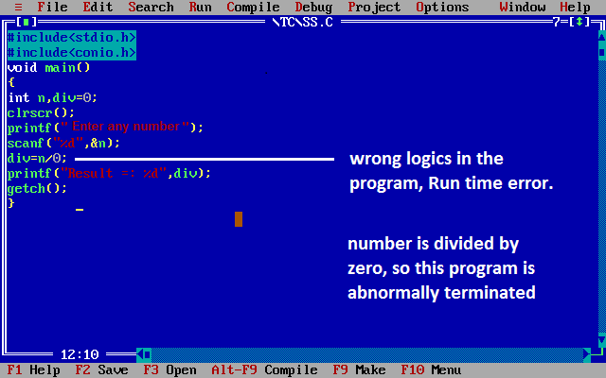
Exception

Slide 39
Exception Handling
An exception is an event - Disrupts the normal flow
An exception is a Python object that represents an error
Python script raises an exception
Handle the exception immediately otherwise it terminates and quits

Slide 40
Handling Exception (try…except)
try:
Suspicious code except Exception1:
Code to handle Exception1 except Exception2:
Code to handle Exception2 else:
if no exception

Slide 41
Example
try:
fh = open("testfile", "w")
fh.write("This is my test file for handling!!") except IOError:
print("Error: can\'t find file”)
else:
print("Written successfully“) fh.close()

Slide 42
Handling Exception (try…finally)
try:
fh = open("testfile", "w") fh.write("This is my file exception”)
finally: # code must be executed
print ("Error: can\'t find file or read data“)

Slide 43
Program for Exception Handling
a=int(input('Enter any number')) try:
c=10/a
except ZeroDivisionError:
print("cant divide any number by zero")
else:
print("success c=%s" %c) finally:
print("Completed")

Slide 44
Summary of the session….
Function and defining functions
Lambda Functions
Exception and handling exceptions

Slide 45
Session Topics
Parallel processing, MAPS and Filtering
Session outcome: The students will be able to implement parallel processing, MAPS and Filtering

Slide 46
Parallel processing
Increase the number of tasks done a program - reduces the overall processing time
Help to handle large scale problems - divide the problem into sub-units that do not depend on
other sub-units (or less dependent).
A problem where the sub-units are totally independent of other sub-units is called embarrassingly parallel.
An element-wise operation on an array. In this case, the operation needs to aware of the
particular element it is handling at the moment.
In another scenario, a problem which is divided into sub-units have to share some data to perform operations. These results in the performance issue because of the communication cost.
7/28/2026

Slide 47
Parallel processing …
Two ways to handle parallel programs:
Shared Memory
  Sub-units can communicate with each other through the same memory space.
  When multiple process access and change the same memory location at the same time?
Use synchronization techniques
(2) Distributed memory
Each process is totally separated and has its own memory space.
Communication is handled explicitly between the processes.
Communication happens through a network interface, it is costlier compared to shared
memory.
7/28/2026

Slide 48
Parallel processing - Threads
Threads are one of the ways to achieve parallelism with shared memory.
These are the independent sub-tasks that originate from a process and share memory.
Global Interpreter Lock (GIL) - threads can’t be used to increase performance in Python.
GIL is a mechanism in which Python interpreter design allow only one Python instruction to run at a time.
GIL limitation can be completely avoided by using processes instead of thread.
7/28/2026

Slide 49
Multiprocessing for parallel processing …
To parallelize simple tasks by creating child processes: use standard multiprocessing module
Provides an easy-to-use interface and contains utilities to handle task submission and synchronization
Process Class
By subclassing multiprocessing.process, you can create a process that runs independently
init method to initialize resource
Process.run() - to write the code for the subprocess
Process.start() - create a new process and will invoke the Process.run() method
7/28/2026

Slide 50
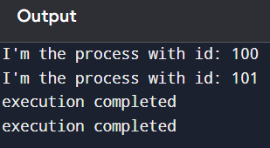
Sample Program
import multiprocessing import time
class Process(multiprocessing.Process): def init (self, id):
super(Process, self). init () self.id = id
def run(self):
time.sleep(5) # 5 seconds
print("I'm the process with id: {}".format(self.id)) time.sleep(5)
print("execution completed") if name == ' main ':
p1 = Process(100) p1.start() p1.join()
p2 = Process(101) p2.start() p2.join()
7/28/2026

Slide 51
Map(), Filter() and Reduce()
Convenient functions that can be replaced with List Comprehensions or loops but offer a more elegant and concise solution to some problems.
Accept a function and a sequence of elements and return the result of applying the received function to each element in the sequence.
7/28/2026

Slide 52
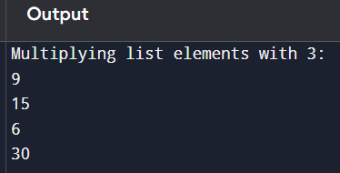
Map() Function
used to perform mathematical operations on two or more lists
map(function, iterable)
function: The function to be used in the code.
iterable: This is the value that is iterated in the code.
# creating a function that returns multiplication result def multiplyNumbers(givenNumbers):
return givenNumbers*3
# map() function applies the multiplyNumbers function for each element of the list
givenNumbers = map(multiplyNumbers, [3, 5, 2,10]) print("Multiplying list elements with 3:")
for element in givenNumbers: print(element)
7/28/2026

Slide 53
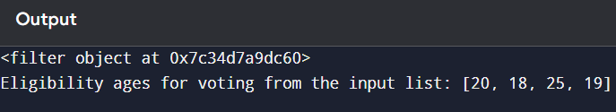
filter() function
checks whether or not the given condition is present in the sequence and then prints the result.
filter(function, iterable)
# creating a function that returns the eligibility ages for voting from the list
def votingAge(givenNumumber): if givenNumumber>=18:
return givenNumumber # input list
inputList = [3, 20, 18, 6, 14, 25, 19]
# Getting only values of above list which are greater than or equal to 18 result_filterObj = filter(votingAge, inputList)
print(result_filterObj) # converting into a list
print("Eligibility ages for voting from the input list:", list(result_filterObj))
7/28/2026

Slide 54
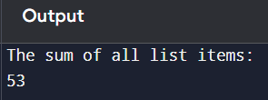
reduce() function
iterates through each item in a list or other iterable data type, returning a single value.
It's in the functools library - more efficient than looping
from functools import reduce
# function that returns the sum of all list items def addNumbers(x, y):
return x+y
inputList = [5, 7, 11, 13, 17]
# Print the sum of the list items using reduce() function print("The sum of all list items:") print(reduce(addNumbers, inputList))
7/28/2026

Slide 55
Summary of the session….
Parallel processing
MAPS
Filtering

Slide 56
Session Topics
Itertools – Generators
Session outcome, The students will be able to:
understand the Itertools and generators and use the same in real time applications.

Slide 57
Itertools
provides various functions that work on iterators to produce complex iterators.
works as a fast, memory-efficient tool that is used either by themselves or in combination to form iterator algebra.
Different types of iterators:
  Infinite iterators
  Combinatoric iterators
  Terminating iterators
7/28/2026
56

Slide 58
Performance comparison – multiply 2 lists
For loop
result = []
for i in range(len(a)):
result.append(a[i] * b[i])
print(result)
Lambda
result = list(map(lambda x, y: x * y, a, b))
print(result)
List Comprehension
result = [x * y for x, y in zip(a, b)]
print(result)
Zip
result = []
for x, y in zip(a, b):
result.append(x * y)
print(result)
Map(operator.mul, )
import operator
result = list(map(operator.mul, a, b))
print(result)
Numpy
import numpy as np
a = np.array([1,2,3,4])
b = np.array([5,6,7,8])
result = a * b
print(result)
import operator
import time
# Defining longer lists for a meaningful performance comparison
a = list(range(1, 10000))
b = list(range(1, 10000))
# Perform multiple measurements for accuracy num_iterations = 5
mapt = []
loopt = []
# Measure the performance of the map function for _ in range(num_iterations):
t1 = time.time()
result = list(map(operator.mul, a, b)) t2 = time.time()
mapt.append(t2 - t1)
7/28/2026
57

Slide 59
Performance comparison – multiply two list
# Measure the performance of the for loop
for _ in range(num_iterations): t1 = time.time()
result = [a[i] * b[i] for i in range(len(a))] t2 = time.time()
loopt.append(t2 - t1)
Average time of map: 0.001268 seconds
Average time of for loop: 0.002143 seconds
# Calculate average times
avg_mapt = sum(mapt) / num_iterations avg_loopt = sum(loopt) / num_iterations
print(f"Average time of map: {avg_mapt:.6f} seconds") print(f"Average time of for loop: {avg_loopt:.6f} seconds")
7/28/2026

Slide 60
Infinite iterators
Iterator in Python is any type that can be used with a ‘for in loop’.
Python lists, tuples, dictionaries, and sets are all iterables
Sometimes iterators can be infinite and such types of iterators are known as Infinite iterators.
Three types of infinite iterators:
(1) count(start, step):
starts printing from the “start” number and prints infinitely. If steps are mentioned, the numbers are skipped else step is 1 by default.
import itertools # for in loop
for i in itertools.count(5, 5):
if i == 35:
break else:
print(i, end=" ")
Output: 5 10 15 20 25 30
7/28/2026

Slide 61
Infinite iterators
(2) cycle(iterable):
prints all values in order from the passed container.
restarts printing from the beginning again when all elements are printed in a cyclic manner.
import itertools count = 0
for i in itertools.cycle('AB'): if count > 7:
break else:
print(i, end=" ") count += 1
Output: A B A B A B A B
7/28/2026

Slide 62
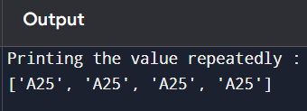
Infinite iterators
(3) repeat(val, num):
repeatedly prints the passed value an infinite number of times.
If num is mentioned, then it repeatedly prints num number of times. # importing "itertools" for iterator operations
import itertools
print("Printing the value repeatedly : ")
print(list(itertools.repeat(‘A25’, 4)))
7/28/2026

Slide 63
Combinatoric iterators
recursive generators that are used to simplify combinatorial constructs such as permutations, combinations, and Cartesian products
Product(): computes the cartesian product of input iterables.
  use the optional repeat keyword argument to specify the number of repetitions.
Permutations(): generate all possible permutations of an iterable.
  All elements are treated as unique based on their position and not their values.
  This function takes an iterable and group_size, if the value of group_size is not specified or is equal to None then the value of group_size becomes the length of the iterable.
Combinations():
  print all the possible combinations(without replacement) of the container passed in arguments in the specified group size in sorted order.
7/28/2026

Slide 64
Combinatoric iterator - Product()
# import the product function from itertools module from itertools import product
print("The cartesian product using repeat:")
print(list(product([1, 2], repeat=2))) print()
The Cartesian product using repeat:
[(1, 1), (1, 2), (2, 1), (2, 2)]
The Cartesian product of the containers:
[('geeks', '2'), ('for', '2'), ('geeks', '2')]
The Cartesian product of the containers: [('A', 3), ('A', 4), ('B', 3), ('B', 4)]
print("The cartesian product of the containers:") print(list(product(['geeks', 'for', 'geeks'], '2'))) print()
print("The cartesian product of the containers:") print(list(product('AB', [3, 4])))
7/28/2026

Slide 65
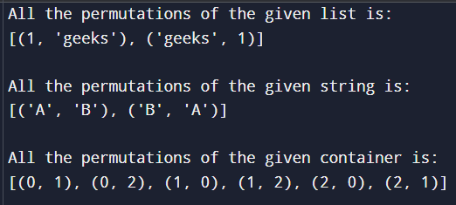
Combinatoric iterator - Permutations()
# import the product function from itertools module from itertools import permutations
print("All the permutations of the given list is:") print(list(permutations([1, 'geeks'], 2)))
print()
print("All the permutations of the given string is:") print(list(permutations('AB')))
print()
print("All the permutations of the given container is:") print(list(permutations(range(3), 2)))
7/28/2026

Slide 66
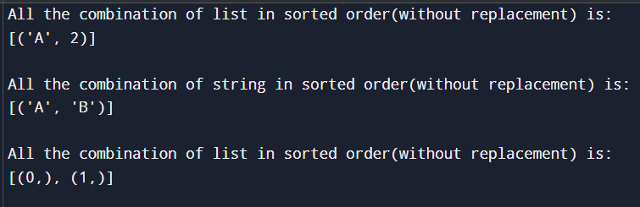
Combinatoric iterator - Combinations()
# import combinations from itertools module from itertools import combinations
print ("All the combination of list in sorted order(without replacement) is:")
print(list(combinations(['A', 2], 2))) print( )
print ("All the combination of string in sorted order(without replacement) is:") print(list(combinations('AB', 2)))
print( )
print ("All the combination of list in sorted order(without replacement) is:") print(list(combinations(range(2), 1)))
7/28/2026

Slide 67
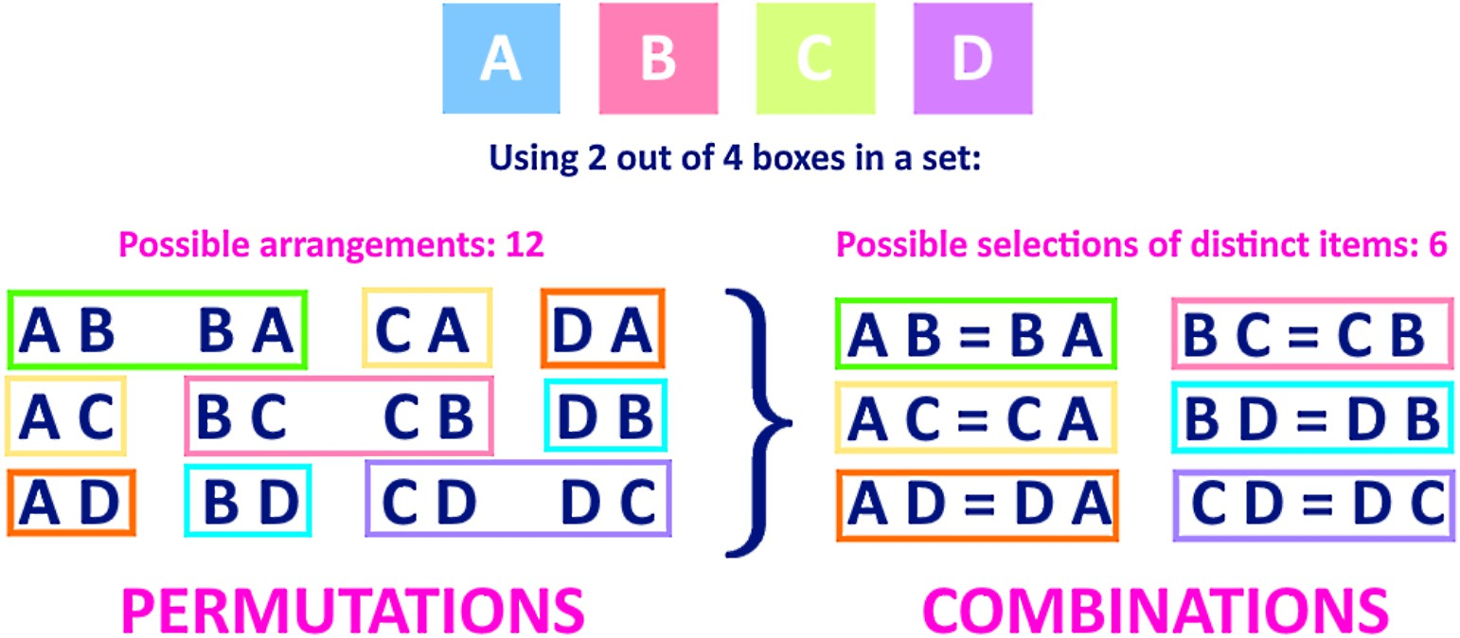
Permutations Vs Combinations
7/28/2026

Slide 68
Terminating iterators
Terminating iterators are used to work on the short input sequences and produce the output based on the functionality of the method used.
Types of terminating iterators are:
accumulate(iter, func):
  Arguments are iterable target and the function which would be followed at each iteration of value in target.
  If no function is passed, addition takes place by default.
  If the input iterable is empty, the output iterable will also be empty.
7/28/2026

Slide 69

Terminating iterator - accumulate(iter, func)
import itertools import operator # initializing list 1 li1 = [1, 4, 5, 7]
# prints the successive summation of elements print("The sum after each iteration is : ", end="") print(list(itertools.accumulate(li1)))
# prints the successive multiplication of elements print("The product after each iteration is : ", end="") print(list(itertools.accumulate(li1, operator.mul)))
7/28/2026

Slide 70
Terminating iterator - chain(iter1, iter2..)
chain(iter1, iter2..):
to print all the values in iterable targets one after another mentioned in its arguments
import itertools
# initializing list 1 li1 = [1, 4, 5, 7]
# initializing list 2 li2 = [1, 6, 5, 9]
Output:
Values in mentioned chain are : [1, 4, 5, 7, 1, 6, 5, 9, 8, 10, 5, 4]
# initializing list 3 li3 = [8, 10, 5, 4]
print(“Values in mentioned chain are : ", end="")
print(list(itertools.chain(li1, li2, li3)))
7/28/2026

Slide 71
Terminating iterator - compress(iter, selector)
compress(iter, selector):
selectively picks the values to print from the passed container according to the boolean list value passed as other arguments.
The arguments corresponding to boolean true are printed else all are skipped.
import itertools
# using compress() selectively print data values
print("The compressed values in string are : ", end="") print(list(itertools.compress('GEEKSFORGEEKS', [1, 0, 0, 0, 0, 1, 0, 0, 1, 0, 0, 0, 0])))
Output: The compressed values in string are : ['G', 'F', 'G']
7/28/2026

Slide 72
Terminating iterator - dropwhile(func, seq)
dropwhile(func, seq):
starts printing the characters only after the func. in argument returns false for the first time.
import itertools
Output:
The values after condition returns false : [5, 7, 8]
# initializing list li = [2, 4, 5, 7, 8]
print ("The values after condition returns false : ", end ="") print (list(itertools.dropwhile(lambda x : x % 2 == 0, li)))
7/28/2026

Slide 73
Terminating iterator - filterfalse(func, seq)
filterfalse(func, seq):
prints only values that return false for the passed function.
import itertools # initializing list li = [2, 4, 5, 7, 8]
Output:
Values that return false to function are : [5, 7]
print (“Values that return false to function are : ", end ="") print (list(itertools.filterfalse(lambda x : x % 2 == 0, li)))
7/28/2026

Slide 74
Terminating iterator - starmap(func., tuple list) starmap(func., tuple list):
takes a function and tuple list as argument and returns the value according to the function from each tuple of the list.
import itertools
# initializing tuple list
li = [ (1, 10, 5), (8, 4, 1), (5, 4, 9), (11, 10, 1) ]
# selects min of all tuple values
print ("The values acc. to function are : ", end ="") print (list(itertools.starmap(min, li)))
Output: The values acc. to function are : [1, 1, 4, 1]
7/28/2026

Slide 75
Terminating iterator - takewhile(func, iterable)
takewhile(func, iterable):
opposite of dropwhile() - prints the values till the function returns false for 1st time.
import itertools
# initializing list
li = [2, 4, 6, 7, 8, 10, 20]
Output:
The list values till 1st false value are : [2, 4, 6]
# using takewhile() to print values till condition is false. print ("The list values till 1st false value are : ", end ="") print (list(itertools.takewhile(lambda x : x % 2 == 0, li )))
7/28/2026

Slide 76
Generators
Generator functions are a powerful tool for creating iterators
is a special type of function that returns an iterator object.
Instead of using return to send back a single value, generator functions use yield to produce a series of results over time.
allows the function to generate values and pause its execution after each yield, maintaining its state between iterations.
When the generator function is called, it does not execute the function body immediately. Instead, it returns a generator object that can be iterated over to produce the values.
7/28/2026

Slide 77
Generators
Syntax to create a generator:
def generator_name(arg): # statements
yield something
Defined using the def keyword, but instead of the return statement we use the yield statement.
Here, the yield keyword is used to produce a value from the generator.
7/28/2026

Slide 78
Example for Generator
def my_generator(n): # initialize counter value = 0
# loop until counter is less than n
while value < n:
# produce the current value of the counter
yield value
value += 1
# iterate over the generator object produced by my_generator for value in my_generator(3):
# print each value produced by generator
print(value)
0
1
2
7/28/2026

Slide 79
Yield vs Return
Yield: is used in generator functions to provide a sequence of values over time. When yield is executed, it pauses the function, returns the current value and retains the state of the function. This allows the function to continue from the same point when called again, making it ideal for generating large or complex sequences efficiently.
Return: on the other hand, is used to exit a function and return a final value. Once return is executed, the function is terminated immediately, and no state is retained. This is suitable for cases where a single result is needed from a function.
7/28/2026

Slide 80
Use of Python Generators
Easy to Implement
  Generators can be implemented in a clear and concise way as compared to their iterator class counterpart.
sequence of power of 2 using generator
def PowTwoGen(max=0):
n = 0
while n < max: yield 2 ** n n += 1
gen = PowTwoGen(3)
print(next(gen)) - 1
print(next(gen)) - 2
print(next(gen)) - 4
#print(next(gen)) – StopIteration Exception
sequence of power of 2 using an iterator class.
class PowTwo:
def init (self, max=0): self.n = 0
self.max = max
def iter (self):
return self
def next (self): if self.n > self.max:
raise StopIteration result = 2 ** self.n self.n += 1
return result
7/28/2026

Slide 81
Use of Python Generators
(2) Memory Efficient
A normal function to return a sequence will create the entire sequence in memory before returning the result. This is an overkill, if the number of items in the sequence is very large.
Generator implementation of such sequences is memory friendly and is preferred since it only produces one item at a time.
(3) Represent Infinite Stream
Generators are excellent mediums to represent an infinite stream of data. Infinite streams cannot be stored in memory, and since generators produce only one item at a time, they can represent an infinite stream of data.
def all_even():
n = 0
while True: yield n
n += 2
gen = all_even()
print(next(gen)) - 2
print(next(gen)) - 4
print(next(gen)) - 6
print(next(gen)) - 8
7/28/2026

Slide 82
Use of Python Generators
Pipelining Generators:
Multiple generators can be used to pipeline a series of operations.
produces the numbers in the Fibonacci series and to find out the sum of squares of numbers in the Fibonacci series,
def fibonacci_numbers(nums):
x, y = 0, 1
for _ in range(nums): x, y = y, x+y
yield x
def square(nums): for num in nums:
yield num**2 print(sum(fibonacci_numbers(5))) print(sum(square(fibonacci_numbers(5))))
# Output:
12
40
7/28/2026

Slide 83
Use of Python Generators
Generators are especially useful for processing large data files, like logs, because:
  They handle data in small parts, saving memory
  They don’t load the entire file at once
  While iterators can do similar tasks, generators are quicker to write since you don’t need to define next and iter methods manually.
7/28/2026

Slide 84
Summary of the session….
Itertools
Generators

